Slide 1
Environments
COMP 30240/41400: Multi-Agent Systems
Lecturer: Rem Collier
Email: rem.collier@ucd.ie

Slide 2
The Environment Layer
Last week, we programmed agents as mental entities:
They manipulated their beliefs in a way that allowed them to simulate, for example, building block towers.
In reality, it is expected that agents will operate as embodied entities:
They will manipulate entities that exist within some real/virtual domain.
To achieve this, we need to introduce the idea of an environment layer.
This is the part of the system that defines possible interactions between the agents and the world they inhabit.

Slide 3
The Environment Layer
The environment is a first-class abstraction that provides the surrounding conditions for agents to exist and that mediates both the interaction among agents and the access to resources
[Weyns, Omicini, Odell, 2007]

Slide 4
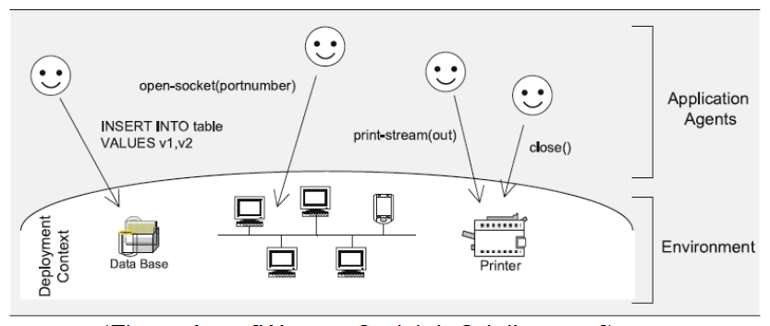
Environment Support Levels
Basic: The environment enables agents to access the deployment context.
i.e. hardware and software and external resources with which the MAS interacts.

Slide 5
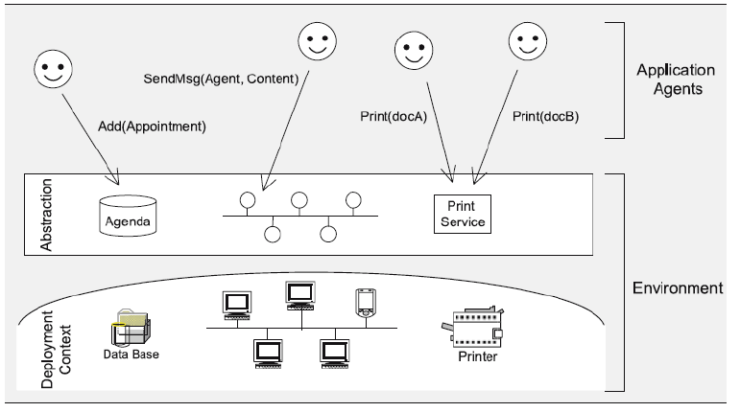
Environment Support Levels
Abstraction: Bridges the conceptual gap between the agent abstraction and low-level details of the deployment context.
Shields low-level details of deployment context

Slide 6
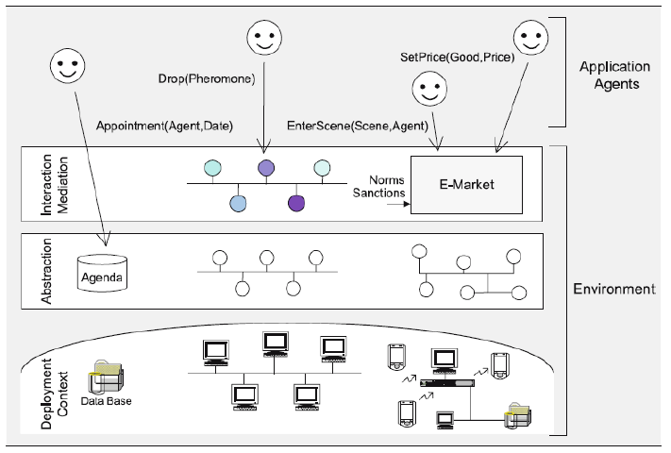
Environment Support Levels
Interaction-Mediation: Regulate the access to shared resources / mediate interaction between agents.

Slide 7
Environment Features
The environment provides the surrounding conditions for agents to exist
On their own, agents are just loci of control
The environment provides the glue that connects agents into a working system….
The environment mediates both the interaction among agents and access to resources
The environment is an active entity w.r.t. specific responsibilities in the MAS
It provides a medium for sharing information and mediating coordination among agent.
The environment not only enables interaction, it also constrains it
As such the environment provides a design space that can be exploited by the designer…

Slide 8
Environments in Jason

Slide 9
Environments in Jason
To program an environment in Jason, you simply extend the jason.environment.Environment class.
public class TestEnv extends jason.environment.Environment {
/** Called before the MAS execution with the args informed in .mas2j */
@Override
public void init(String[] args) { }
/** Called by agent to perform an external action */
@Override
public boolean executeAction(String agName, Structure action) {
return false;
}
/** Called before the end of MAS execution */
@Override
public void stop() { super.stop(); }
}

Slide 10
Example: Fire Environment
public class TestEnv extends jason.environment.Environment {
private Logger logger = Logger.getLogger("testenv.mas2j."+TestEnv.class.getName());
/** Called before the MAS execution with the args informed in .mas2j */
@Override public void init(String[] args) { }
@Override public boolean executeAction(String agName, Structure action) {
if (action.getFunctor().equals("burn")) {
addPercept(Literal.parseLiteral("fire"));
return true;
} else {
logger.info("executing: "+action+", but not implemented!");
return false;
}
}
/** Called before the end of MAS execution */
@Override public void stop() { super.stop(); }
}

Slide 11
Example: Fire Environment
The sample_agent.asl file:
!start.
+!start : true <- burn.
+fire <- .println("there is a fire").
The testEnv.mas2j deployment descriptor:
MAS fire {
infrastructure: Centralised
environment: FireEnv
agents:
agent1 sample_agent;
aslSourcePath:
"src/asl";
}

Slide 12
Example: TowerWorld
Lets build an environment ourselves…

Slide 13
Discussion
Perception is hidden from the environment developer
Percepts stored in the environment.
Updating of perceptions is a function of the environment.
What about dynamic environments?
All actions are invoked via the executeAction method.
Must code agent specific actions.
No association between action and agent program.
Environments are not modular
Cannot easily reuse part of an environment
Coding is language specific!

Slide 14
Environment Interface Standard

Slide 15
Environment Interface Standard
Known as EIS.
Attempt to standardise the implementation of environments.
Write one use anywhere philosophy.
Defines a standard interface that languages must adhere to.
Defines a standard interface that environment developers must adhere to.
The environment is packaged as a jar file.
EIS layer knows how to load and read the jar file.
EIS layer exposes available resources (entities) to the agent layer.
EIS layer links agents to entities on demand.

Slide 16
EIS Functions
Interface functions
attaching, detaching, and notifying observers (software design pattern);
registering and unregistering agents;
adding and removing entities;
managing the agents-entities-relation;
performing actions and retrieving percepts;
managing the environment
Interface Intermediate Language (IIL)
to facilitate data-exchange
encoding percepts, actions, events

Slide 17
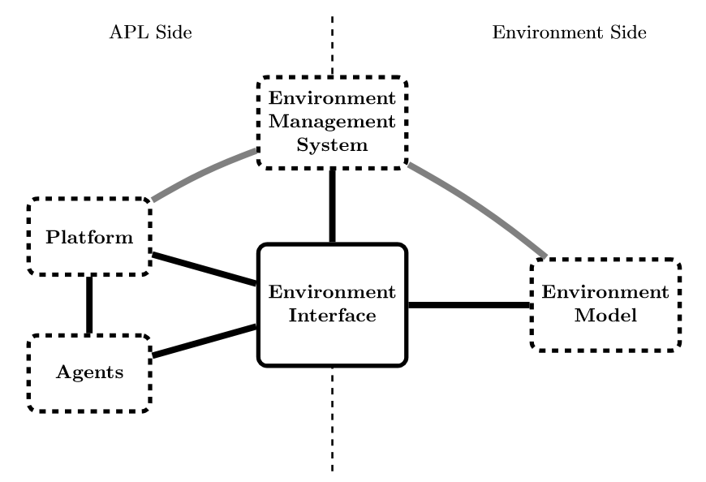
EIS Meta Model

Slide 18
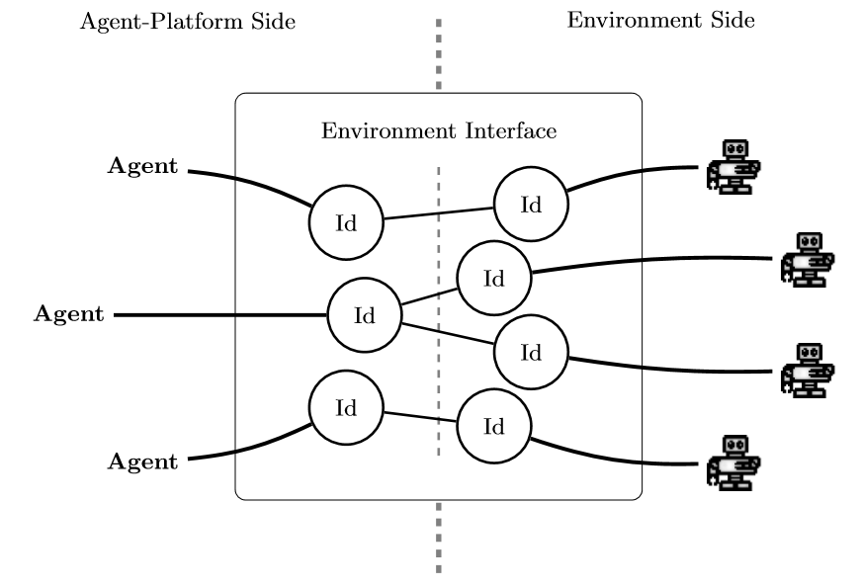
EIS: Functional View

Slide 19
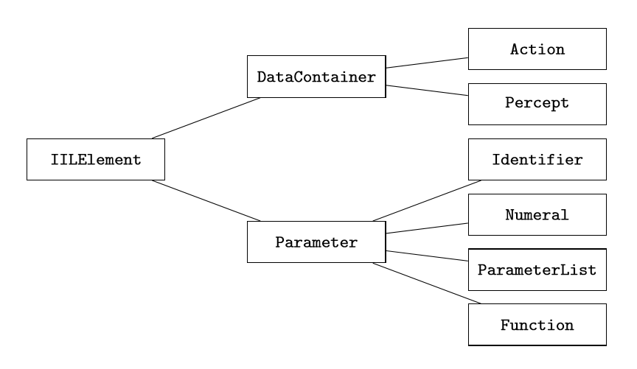
EIS: IIL

Slide 20
EIS and Jason
Jason offers an integration with EIS
Packaged as jason-eis-0.3.jar
Compliant with version 0.3 of EIS (current release 0.5)
Configuration of the environment is through the mas2j deployment file.
MAS tower {
…
environment: jason.eis.EISAdapter(
"lib/towerenv.jar“, // location of environment
agent_entity(agent1,gripper)) // assoc. agent with entity
…
}

Slide 21
Example: Towerworld
Requires: eis-0.3.jar, jason-eis-0.3.jar, towerenv.jar
MAS towereis {
infrastructure: Centralised
environment: jason.eis.EISAdapter(
"lib/towerenv.jar",
agent_entity(agent1,gripper))
agents:
agent1 sample_agent;
aslSourcePath:
"src/asl";
}
Entity name
Make sure names match

Slide 22
Example: Towerworld
!start.
// Illustrative program
+!start : true <-
pickup(a);
.wait(holding(a)); // need to wait as actions are durative!
putdown(a,b).

Slide 23
EIS Environments
A range of standard EIS Environments is now available:
https://github.com/eishub
Current version of EIS: 0.5
Alpha version 0.5 bridge also available on moodle
Vacworld (v0.5) is an implementation of blocks world.

Slide 24
Agents & Artifacts Model

Slide 25
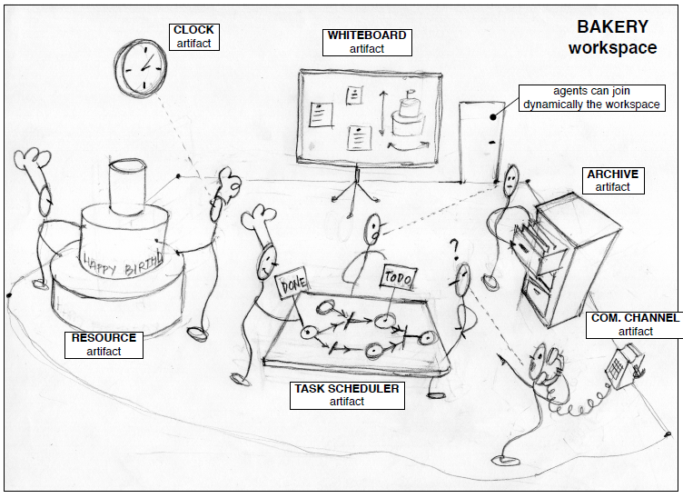
Overview
Perspective: environments are workspaces containing artifacts that agents create, share, use, adapt for their work (based on Activity Theory)

Slide 26
A&A Basic Concepts
Agents
Autonomous, goal/task oriented entities
Proactive, reactive, social, …
Create and co-use artifacts for supporting their activities
In addition to direct communication
Artifacts
Non-autonomous, function oriented entities
Controllable and observable
Modelling the resources and tools used by agents
Designed by MAS programmers
First-class entities for agents
Workspaces
Grouping agents and artifacts
Defining the topology or the computational environment

Slide 27
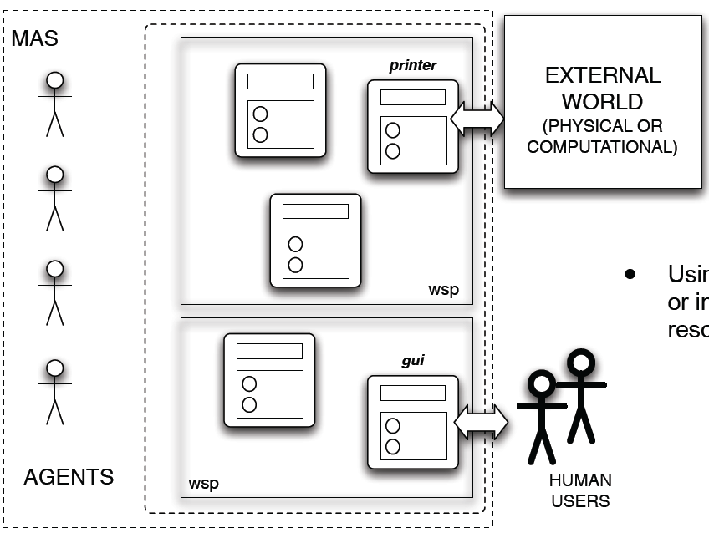
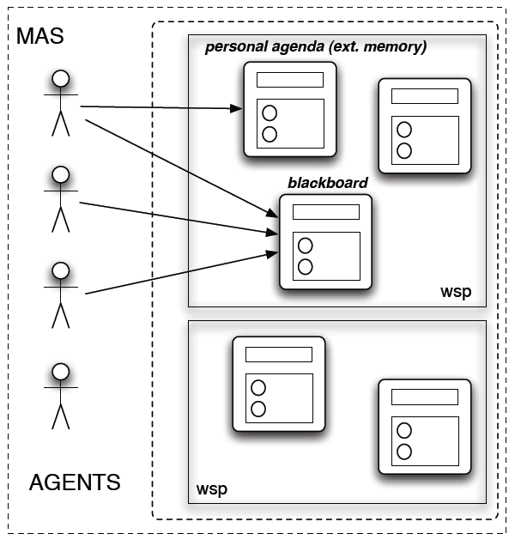
Abstraction Layer
Artifacts are modules =
Artifacts can represent or interact with external resources / users
reusable units of functionality
Artifacts can represent internal resources.

Slide 28
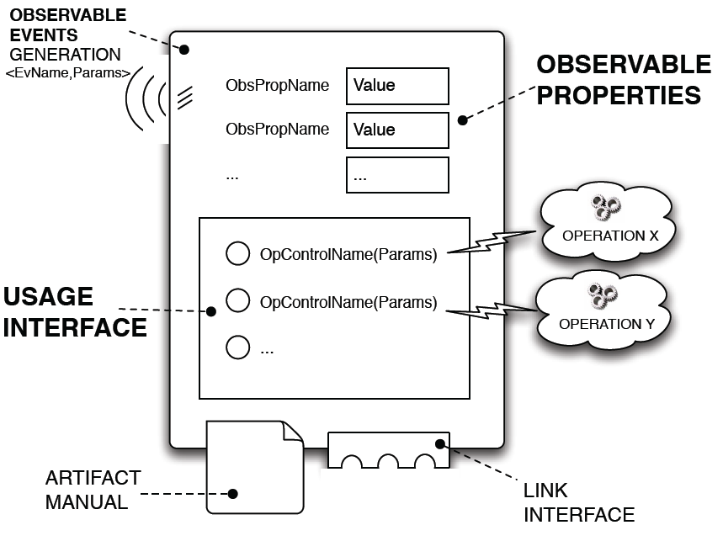
Artifact Model

Slide 29
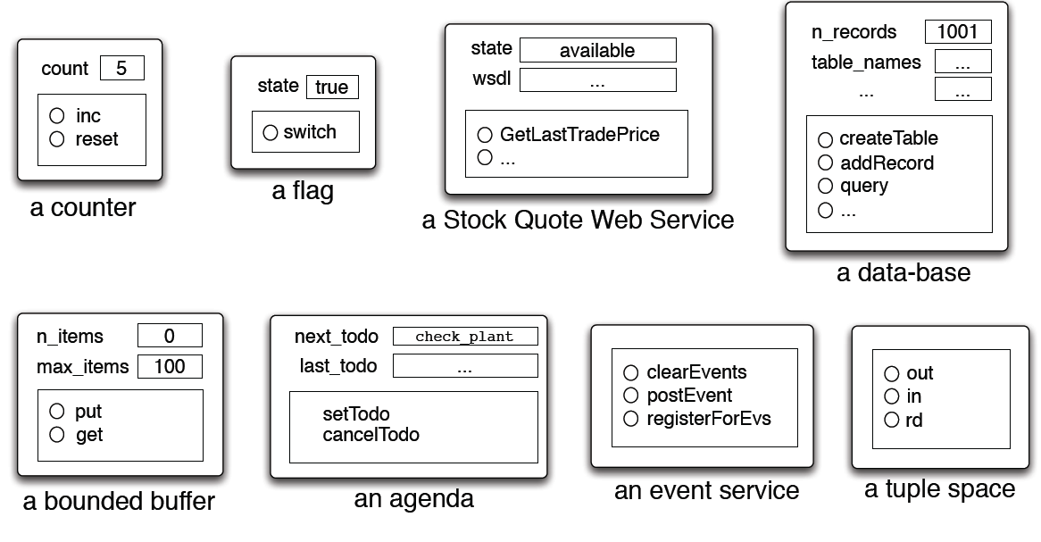
Examples

Slide 30
Agent-Artifact Interaction
Based on the concepts of use and observation.
Triggering and controlling the execution of operations by “acting” on an artifact usage interface
Perceiving events generated by operation execution
Beliefs representing events happening in the artifact or as first-class events
Perceiving artifact observable properties
Beliefs representing the state of the artifact

Slide 31
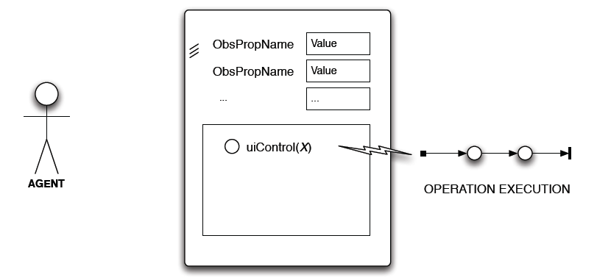
Interaction Model: Use
artifact operation execution
Asynchronous w.r.t. agent
Possibly a process structured in multiple atomic steps

Slide 32
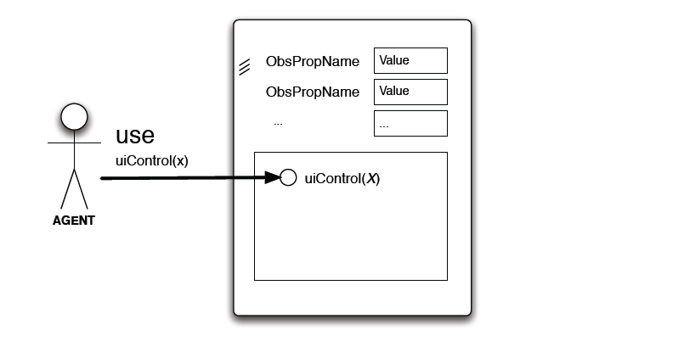
Interaction Model: Use
use action
Acting on op. controls to trigger op execution
Synchronization point with artifact time/state

Slide 33
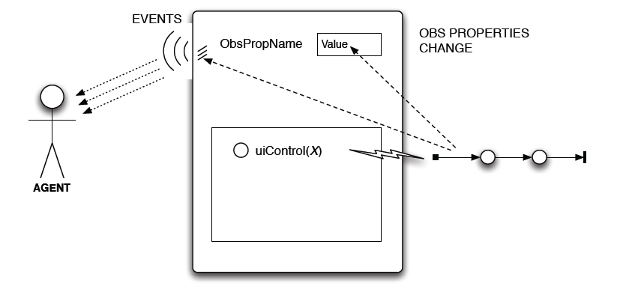
Interaction Model: Use
observable events
Observable events & changes in observable property
Perceived by agents either as (external) events or beliefs

Slide 34
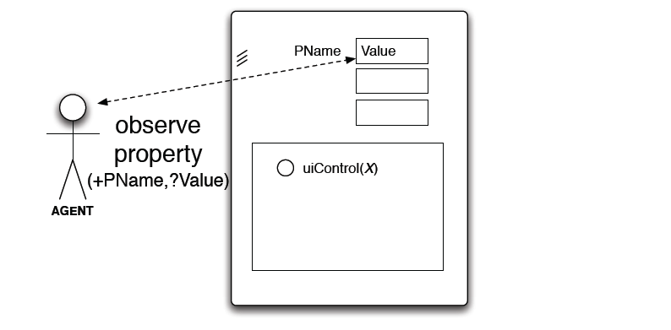
Interaction Model: Observation
observeProperty action
Value of an obs. Property as action feedback
No interaction

Slide 35
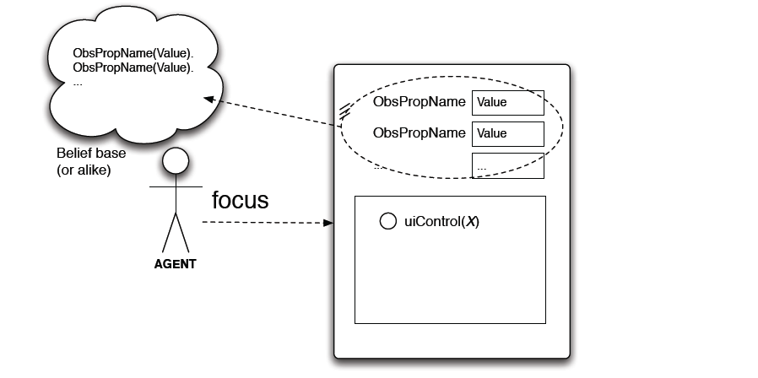
Interaction Model: Observation
focus / stopFocus action
Start / stop a continuous observation of an artifact
Possibly specifying filters
Observable properties represented as beliefs

Slide 36
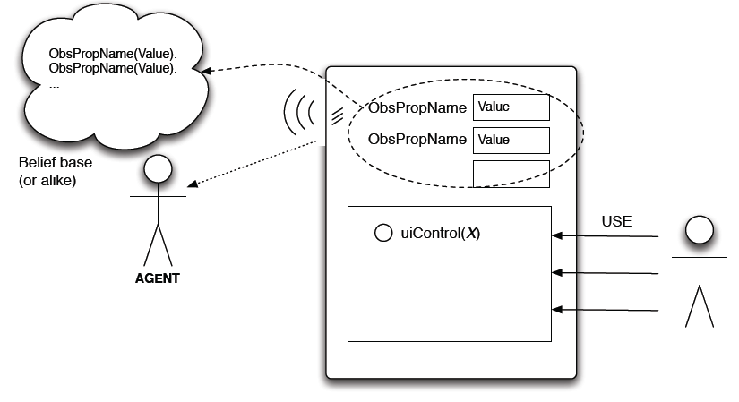
Interaction Model: Observation
continuous observation
Observable events (> agent events / beliefs)
Observable properties (> belief base update)

Slide 37
Artifact Model Features
Artifacts as controllable and observable devices
Operation execution as a (possibly long-term) controllable process.
Two observable levels: Properties, events
Transparent management of concurrency issues
Synchronization, mutual-exclusion, etc.
Composability through linking
Also across workspaces
Cognitive use of artifacts through the manual
Function description, operating instructions

Slide 38
Categories of Artifacts
Personal Artifacts
Designed to provide functionalities for a single agent use
E.g. agenda
Social Artifacts
Designed to provide some kind of global functionalities
Communication, coordination, organisation, …
E.g. blackboards, tuple spaces, bounded buffers, …
Boundary Artifacts
Designed to wrap the interaction with external systems of to represent an external system within the MAS
E.g. database, GUI, web services, …

Slide 39
CArtAgO (Uni Bologna)
Platform / infrastructure implementing the A&A model
Runtime environment for executing (possibly distributed) artifact-based environments.
Java–based programming model for defining artifacts
Set of basic APIs for agent platforms to work with artifact-based environments
Distributed and open MAS
Workspaces distributed on Internet nodes
Agents can join and work in multiple workspaces at a time
Role-Based Access Control (RBAC) security model
Open Source Technology:
Available at http://cartago.sourceforge.net

Slide 40
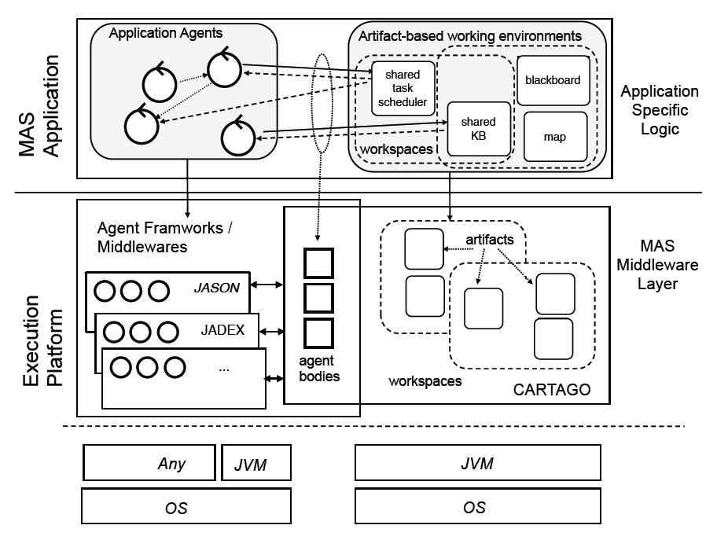
CArtAgO Architecture

Slide 41
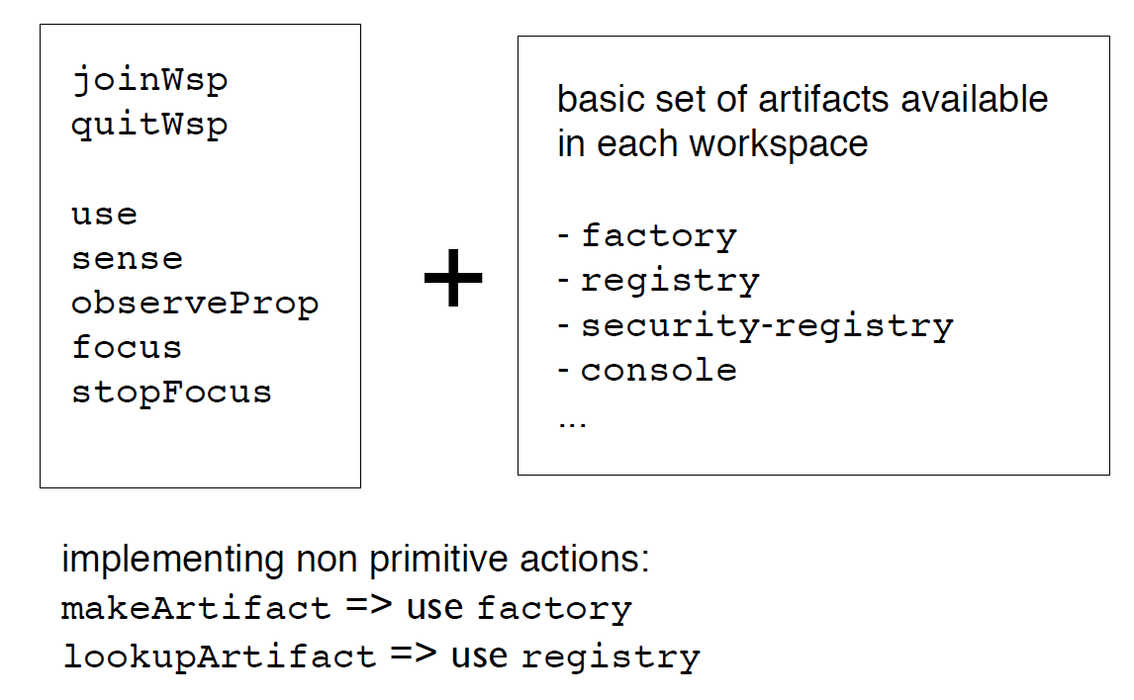
Raw Agent API

Slide 42
Cartago Examples

Slide 43
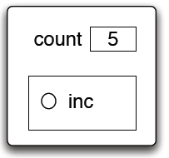
Example 1: Counters
package cartago;
public class Counter extends Artifact {
@OPERATION void init() {
defineObsProperty("count", 0);
}
@OPERATION void inc() {
int count = getObsProperty("count").intValue();
updateObsProperty("count", count + 1);
}
}
A shared counter
OBSERVABLE PROPERTIES:
count: int
USAGE INTERFACE:
inc: { op_exec_started(inc),
count(X),
op_exec_completed(inc) }
initial !create_and_use();
rule +!create_and_use() {
cartago.startService();
cartago.linkAgent();
!setupTool(object<cartago.ArtifactId> C);
int X = 0;
while (X != 15) { CARTAGO(C).inc(); X = X + 1; }
}
rule +!setupTool(object<cartago.ArtifactId> C) {
CARTAGO.makeArtifact("ourCount", "cartago.Counter", prelude.toObjectArray([]), C);
}

Slide 44
Example 1: Counters
package cartago;
public class Counter extends Artifact {
@OPERATION void init() {
defineObsProperty("count", 0);
}
@OPERATION void inc() {
int count = getObsProperty("count").intValue();
updateObsProperty("count", count + 1);
}
}
A shared counter
OBSERVABLE PROPERTIES:
count: int
USAGE INTERFACE:
inc: { op_exec_started(inc),
count(X),
op_exec_completed(inc) }
rule +!observe() {
!myTool(object <cartago.ArtifactId> C);
CARTAGO.focus(C);
}
rule @cartago(string type, string id, count(int V)) : V < 10 {
console.println("count percept: " + V);
}
rule @cartago(string type, string id, count(int V)) :
V == 10 & counter("ourCount", object<cartago.ArtifactId> A) {
console.println("stop observing.");
CARTAGO.stopFocus(A);
}
rule +!myTool(object<cartago.ArtifactId> CounterId) {
CARTAGO.lookupArtifact("ourCount", CounterId);
+counter("ourCount", CounterId);
}

Slide 45
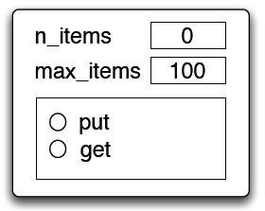
Example 2: Bounded Buffer
Bounded Buffer Artifact for producer-consumer scenarios
public class BBuffer extends Artifact {
private LinkedList<Item> items;
@OPERATION void init(int nmax){
items = new LinkedList<Item>();
defineObsProperty("max_items",nmax);
defineObsProperty("n_items",0);
}
@OPERATION(guard="bufferNotFull") void put(Item obj){
items.add(obj);
updateObsProperty("n_items",items.size()+1);
}
@GUARD boolean bufferNotFull(Item obj){
int maxItems = getObsProperty("max_items").intValue();
return items.size() < maxItems;
}
@OPERATION(guard="itemAvailable") void get(){
Item item = items.removeFirst();
updateObsProperty("n_items",items.size()-1);
signal("new_item",item);
}
@GUARD boolean itemAvailable(){ return items.size() > 0; }
}
OBSERVABLE PROPERTIES:
n_items: int+
max_items: int
USAGE INTERFACE:
put(item:Item) / (n_items < max_items): {...}
get / (n_items >= 0) :
{ new_item(item:Item),...}

